Slide 1


University Institute of Engineering and Technology
University of Jammu
Kathua
Project
“Gesture Control System Using OpenCV”
Presented By : Supervised by:-
Abhishek Gupta(201603001) Er. Archana Salaria
Abhey Sharma (201603002) Lecturer, CSE
Manish Sharma(201603011)
Raghav Khajuria(201603016)

Slide 2
Contents
Introduction
Objectives
Why?
Technologies Used
Modules Created
Workflow
Output
Applications
Challenges and Future Scope

Slide 3
Introduction:
What is Gesture Control?
Gesture control refers to using hand and body movements to interact with digital devices without physically touching them.
Why is it Important?
Enhances user experience by providing a more natural and intuitive way to control devices.
Useful in various fields like gaming, presentations, robotics, and accessibility for individuals with disabilities.
About the Project:
Our project is a Gesture Control System.
It uses a webcam to track hand movements.
The system recognizes specific gestures to control computer applications.
We integrated it with PowerPoint for controlling presentations using hand gestures.
Our project uses Python and its libraries.

Slide 4
p
Objectives:
1. Develop a Gesture Control System:
Create a system that can recognize and interpret hand gestures.
2. Implement Hand Tracking and Gesture Recognition:
Detect hand positions and movements to recognize specific gestures.
3. Control Computer Applications:
Use recognized gestures to control various computer functions (like moving the cursor, clicking, scrolling).
4. Integrate with Presentation Software:
Enable control of PowerPoint presentations through hand gestures for easier and more interactive presentations.

Slide 5
Motivation
1. Accessibility:
Arthritis: Joint pain and stiffness can make gripping a mouse painful.
General Mobility Issues: Helps users who struggle with fine motor skills or have limited hand dexterity.
2. Ease of Use: Reduces strain on hands and wrists.
3. Modern Interaction: Provides a futuristic and innovative way to interact with computers.
4. Hygiene: Reduces the need to touch shared devices, promoting better hygiene, especially important in shared environments.
5. Productivity: Allows for multitasking without the need for physical devices.
6. Entertainment: Enhances the experience in gaming and multimedia applications.

Slide 6
Major Technologies Used:
OpenCV (Open Source Computer Vision Library) : It is an open-source library of programming functions primarily aimed at real-time computer vision and image processing. It provides tools for various tasks like object detection, facial recognition, and image transformation.
Usage in the Project:
Webcam Access
Image Processing
Hand Tracking
2. MediaPipe : MediaPipe is a cross-platform framework developed by Google for building multimodal
machine learning pipelines, particularly for processing and analyzing video, audio, and sensor data in
real-time.
Usage in the Project:
Hand Tracking Model
Landmark Detection
Gesture Recognition

Slide 7
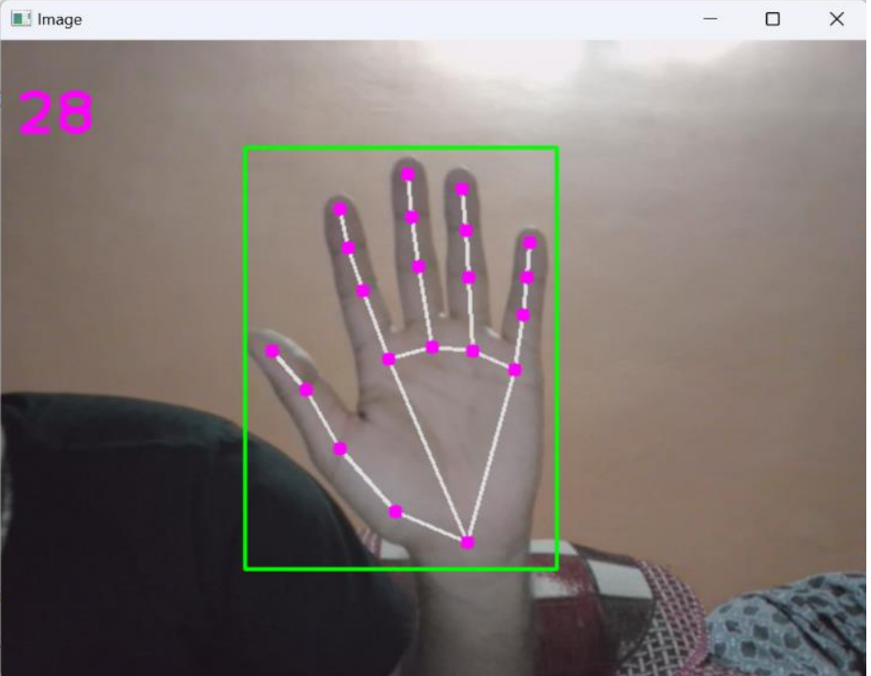
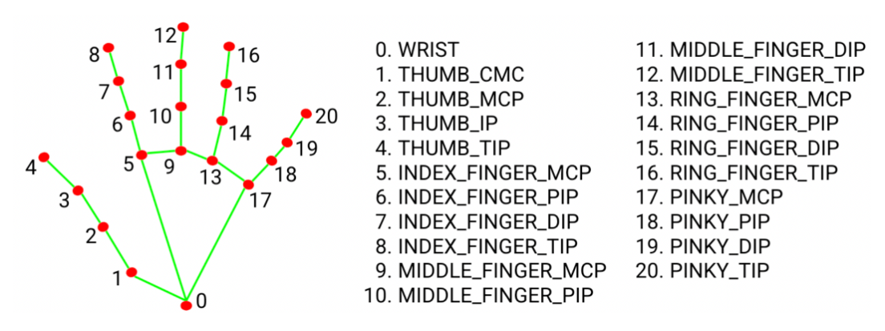
Fig: Detection and Conversion to Hand Landmarks

Slide 8
Other Technologies Used:
PyAutoGUI
Autopy
Comtypes
Inno Setup
cx_freeze
numpy
time
os
keyboard
math

Slide 9
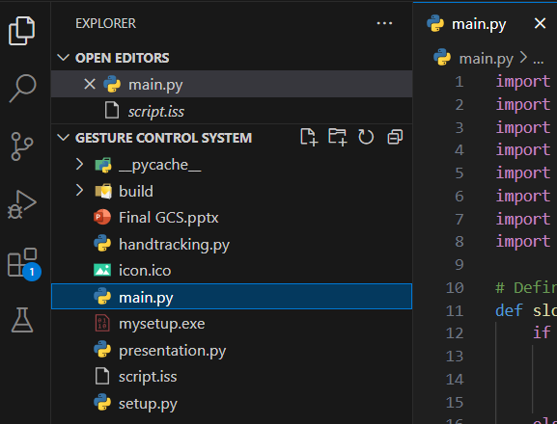
Modules Created:

Slide 10
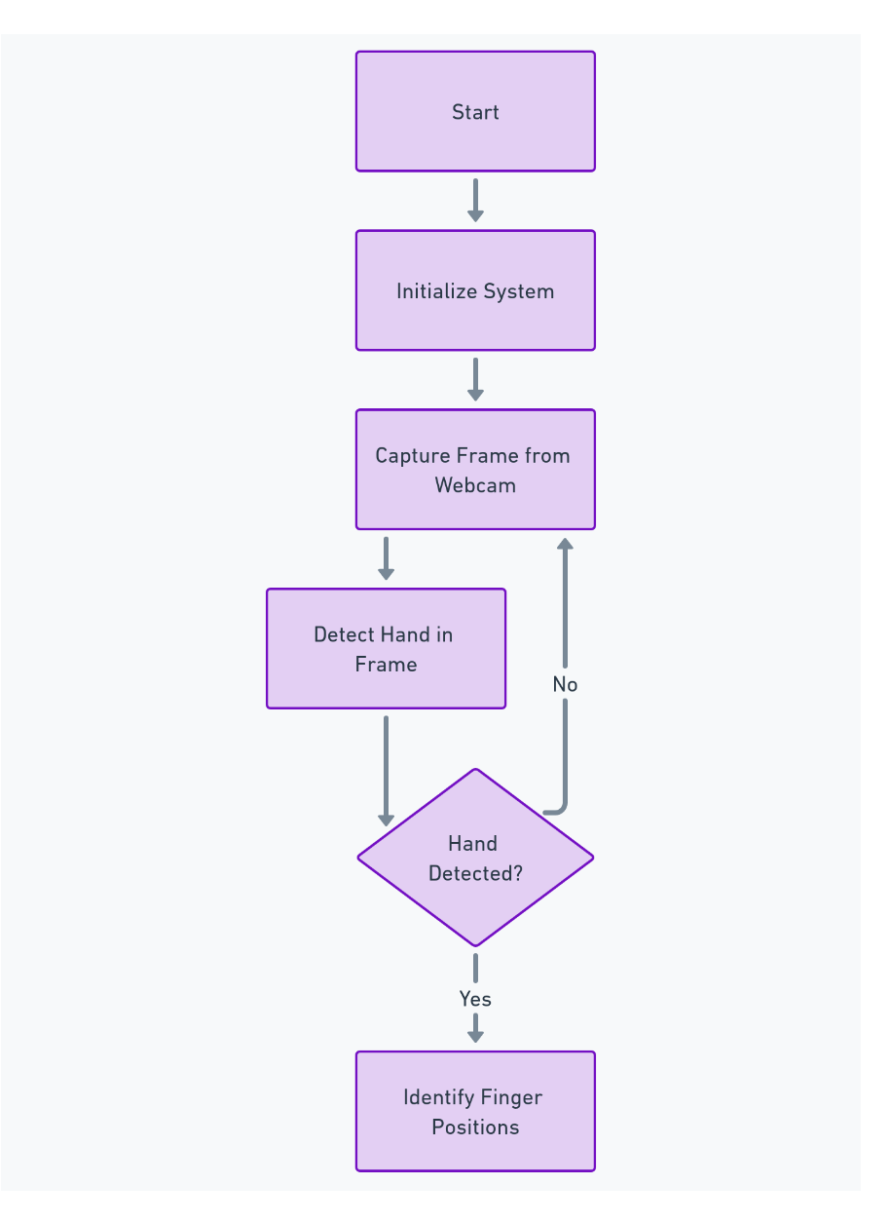
Workflow:
PART -1

Slide 11
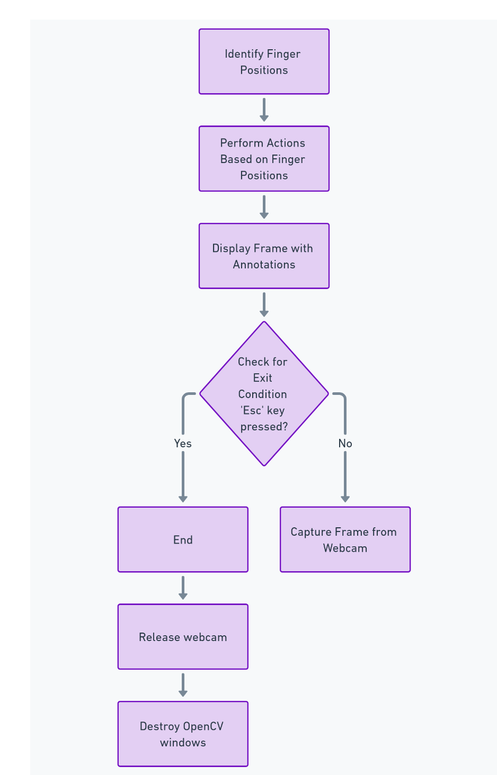
PART-2

Slide 12
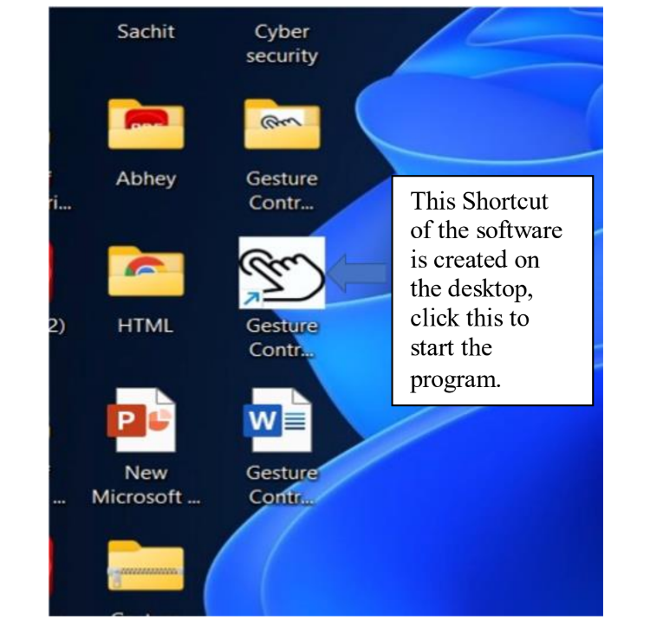
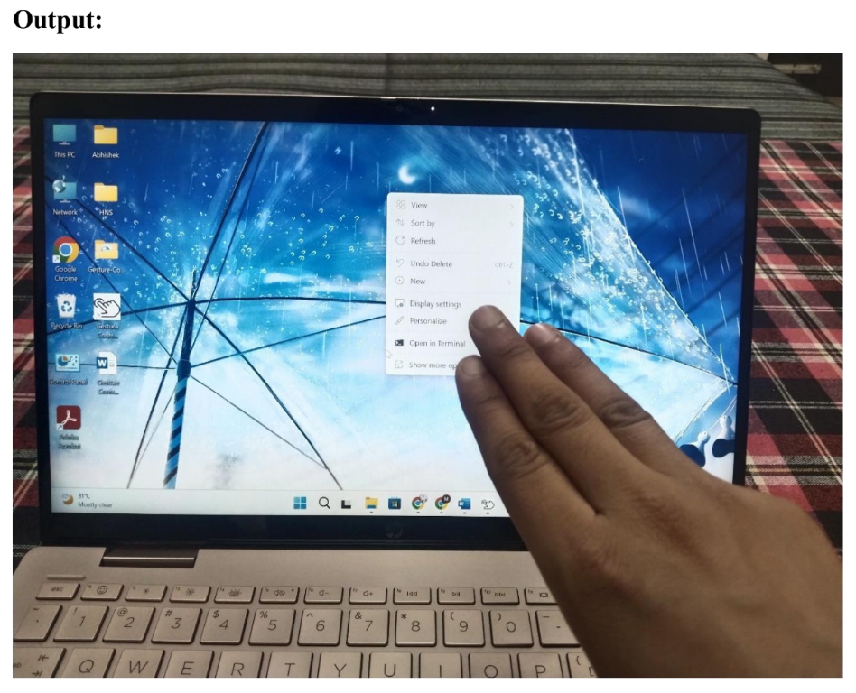
Output:
Fig: Software Created
Fig: Right Click using Hand Gesture

Slide 13
Applications:
1. Education and Business
Interactive Presentations
Multimedia Control
Accessibility
Enhanced Mobility
2. Healthcare
Gesture control can be utilized in medical simulations and training programs to simulate surgical procedures, manipulate medical images, and interact with virtual patient data.
3. Gaming and Entertainment
Gesture control can enhance gaming experiences by allowing players to interact with games using natural hand movements, gestures, and motions. Gesture control can enable users to interact with virtual environments, manipulate objects, and engage in immersive experiences without the need for physical controllers.

Slide 14
Challenges:
Hand Detection Accuracy: Precise detection is challenged by lighting, hand sizes, and occlusions, needing advanced algorithms and tuning.
Real-time Responsiveness: Ensuring low-latency hand-to-mouse translation is difficult with intensive image processing and gesture recognition.
Limitation to Specific Presentation File: Storing the presentation file in the program directory limits flexibility and can cause errors.
Future Scope:
Improved Accuracy and Speed: Advanced machine learning models and GPU acceleration boost hand detection accuracy and gesture recognition speed.
Multi-Hand Support: Dual hand tracking allows for simultaneous recognition of gestures from both hands, enabling more complex interactions.
Integration with More Applications: Extending control to various applications and developing APIs enhances versatility and usability.

Slide 15

Thank You

